Slide 1
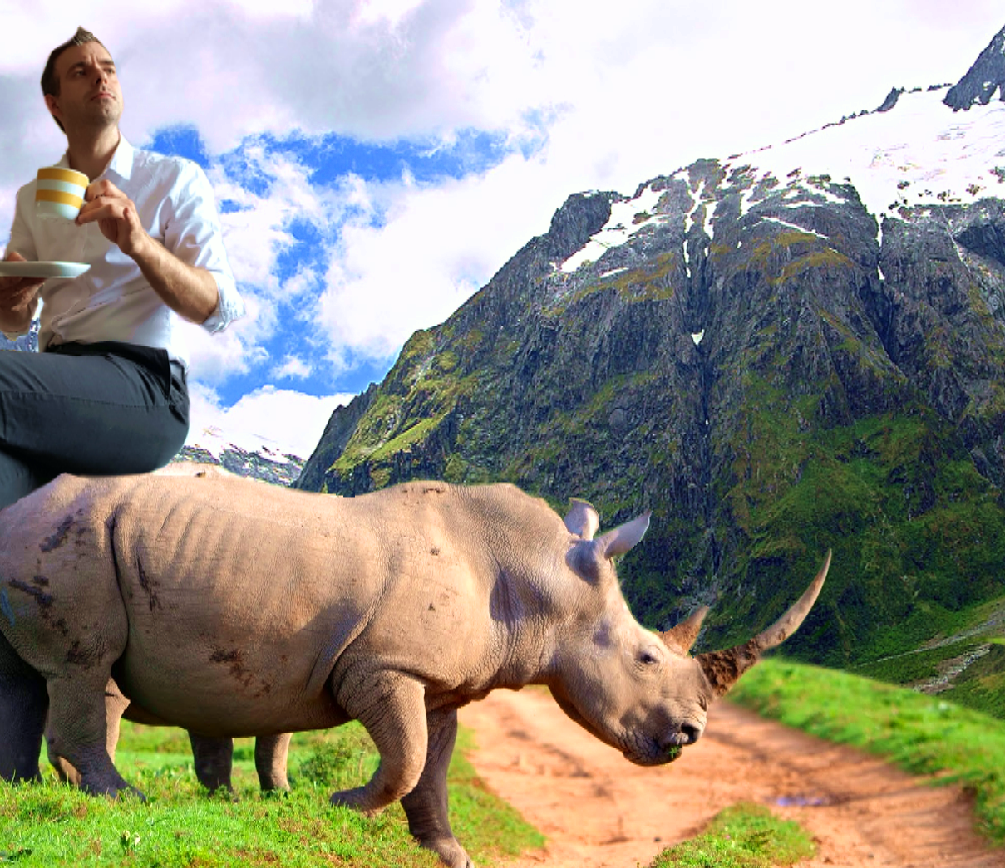
Jeroen Wintraecken productions
I say, lovely weather we’re having!
presents
A powerpoint about reading things

Slide 2
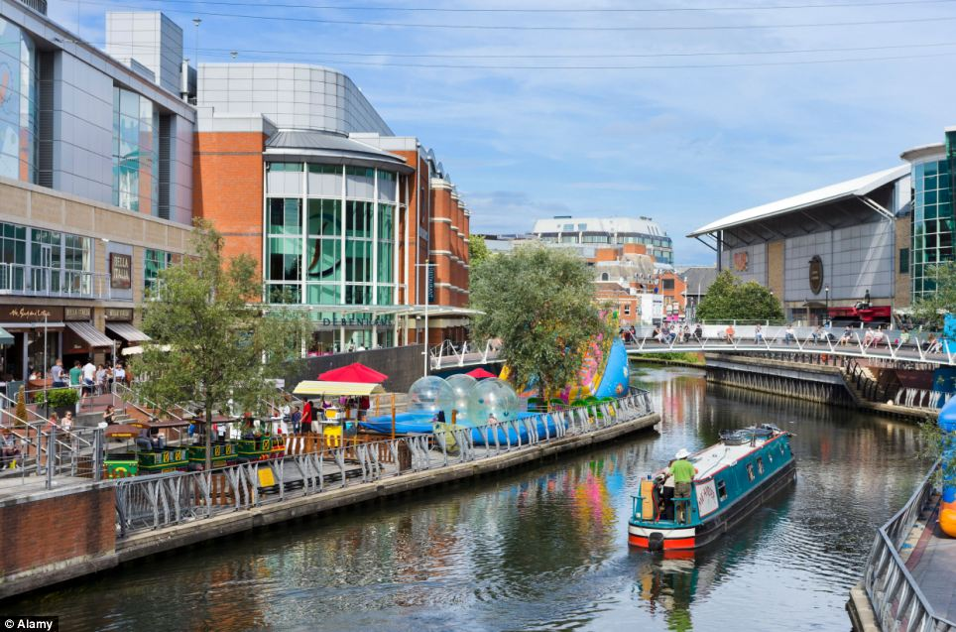
READING
Tips and tricks

Slide 3
Reading strategies
Ways to know what a text is about
without actually reading it

Slide 4
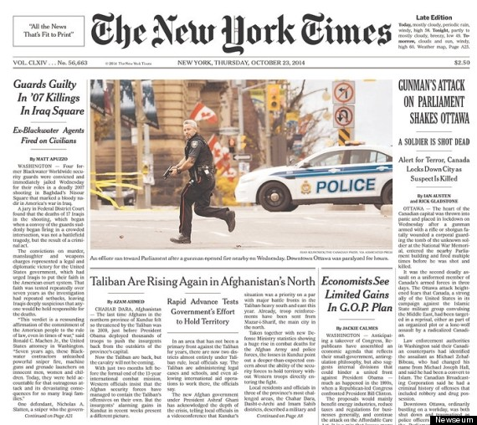
Read titles + headers

Slide 5
Translate the title
Limit
gain
“Limited gains”

Slide 6
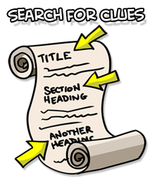
SKIM the page
Look through the text, BUT NOT FOR DETAILS!

Slide 7
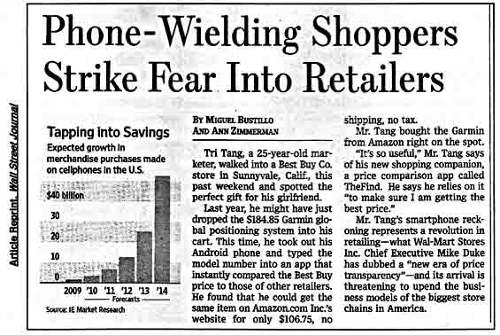
SKIM

Slide 8
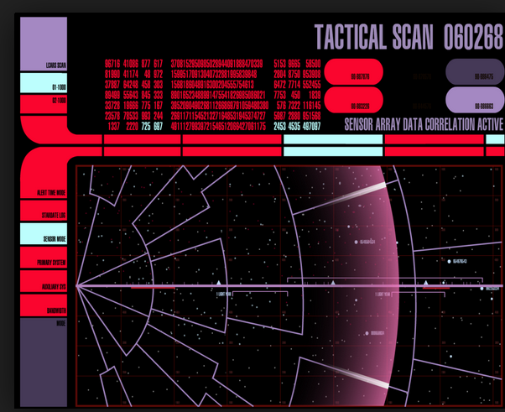
Scan the page

Slide 9
What was mr Tang shopping for?
“Scanning” for a detail

Slide 10
scan

Slide 11
The proper order
Title
(Sub)headers
Skim
Scan
5. All done? Check to see if you have the correct type of answer!

Slide 12
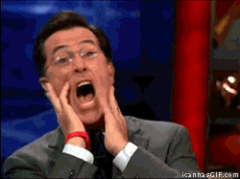
12. How many gifts did mr Tang buy?
GREEN
Your answer: _______________________________

Slide 13
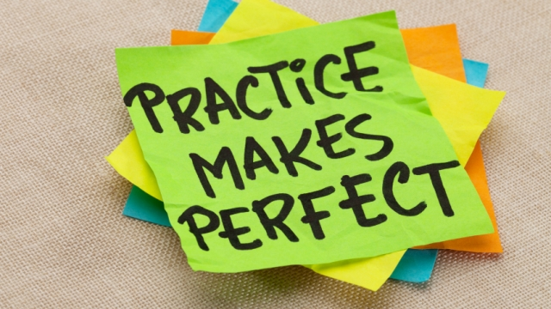
http://juffrouwengels.nl/b1-lezen/

